Slide 1

Word OccurancesApplication
“Parsing a website one word at a time.”
Using javaFX and mySQL database
By: Joanna Smith

Slide 2
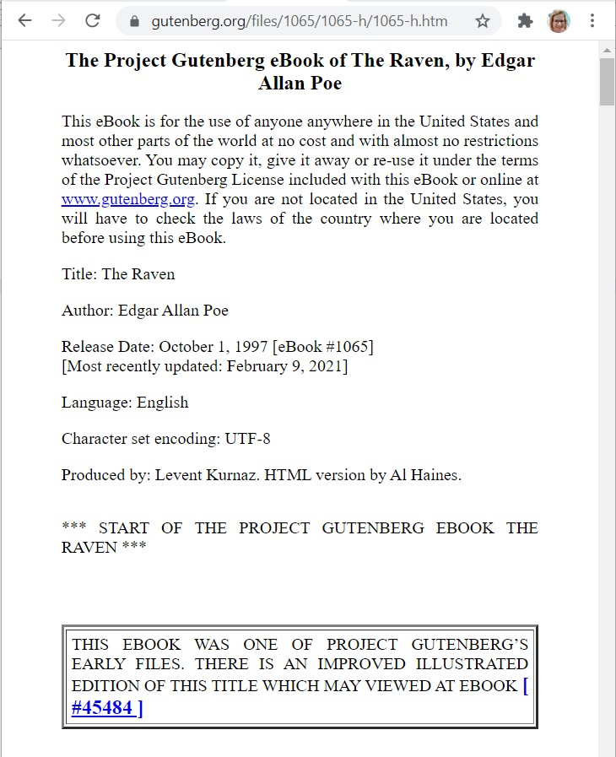
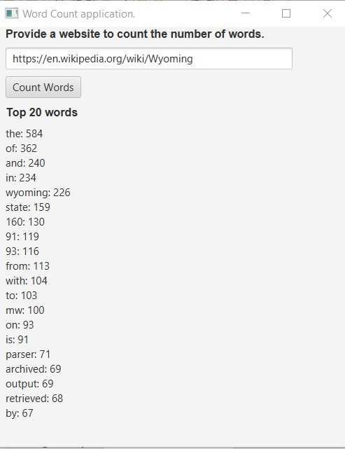
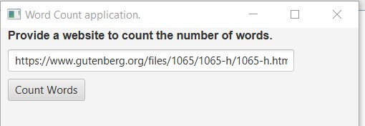
Client and Server Database Application
Client feeds the Server a Website Address after it is Validated
The Server Takes the file and splits it into individual words
And Stores each word in a MySQL database
The Server Grabs a list of the top 20 Words sorted by word count from the database
The client displays those results

Slide 3
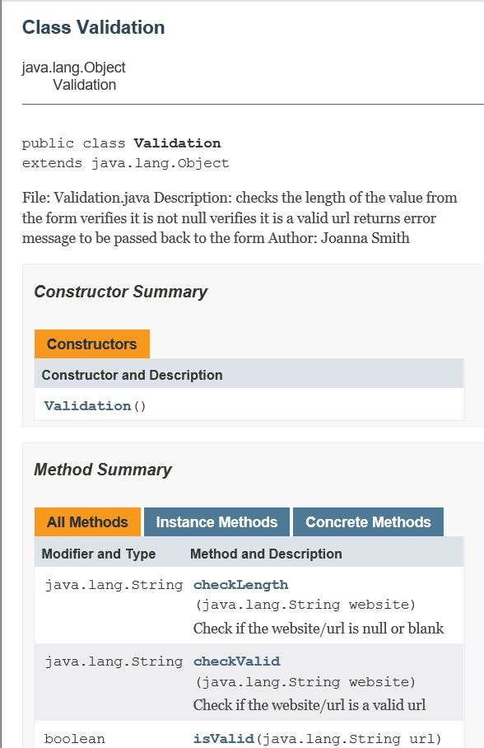
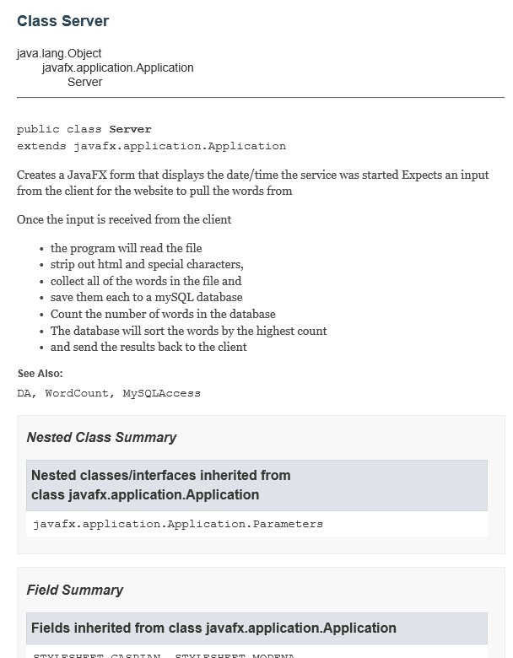
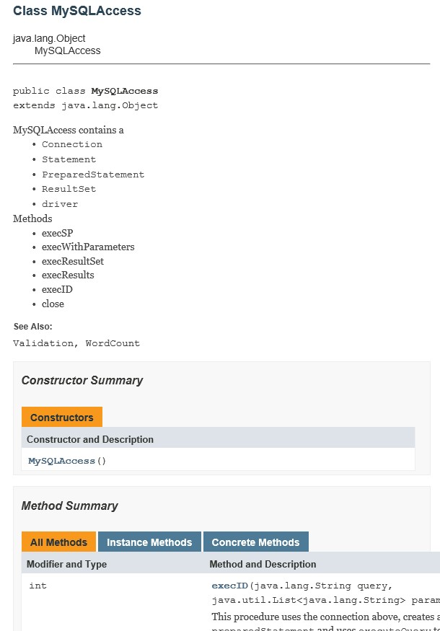
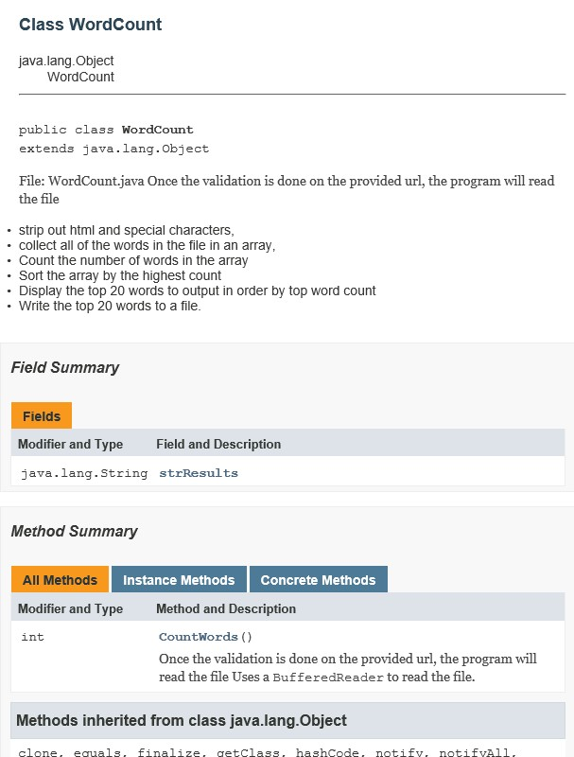
JavaDoc
Documentation of the code behind the madness

Slide 4
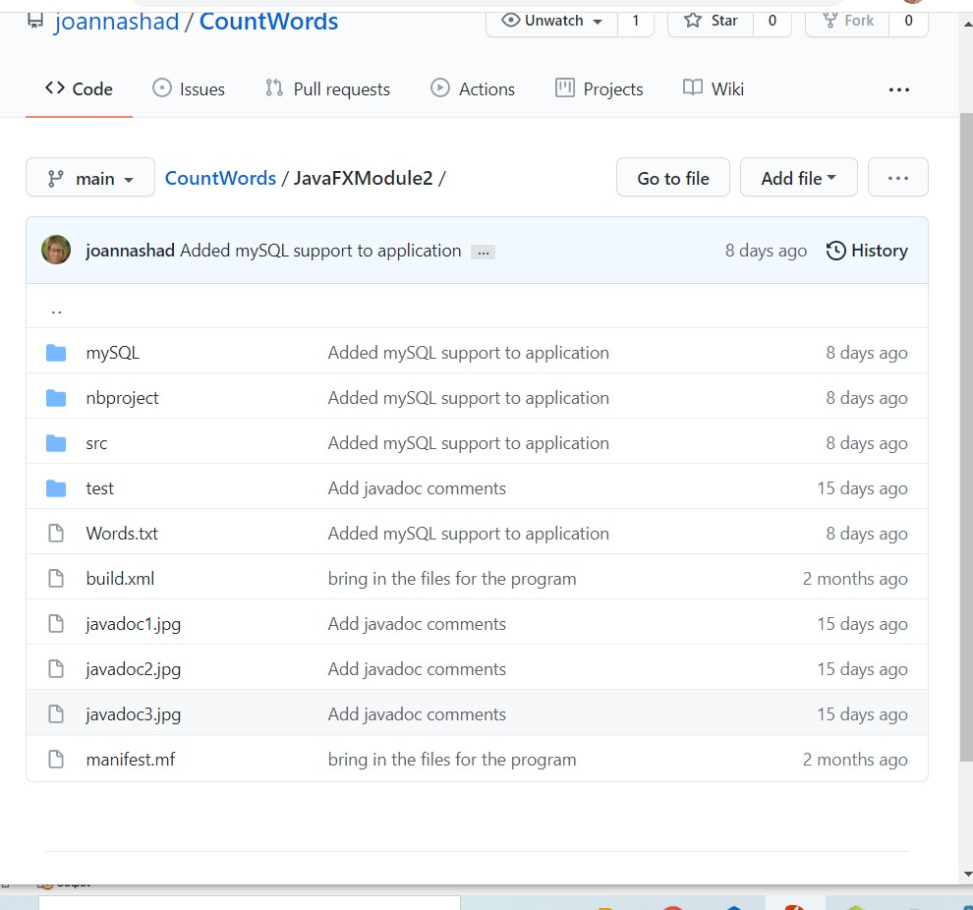
GitHub
Files are stored, maintained, and organized on the cloud in GitHub.
GitHub is a good free resource for source control. The source files from all the projects in this application can be found in GitHub
https://github.com/ joannashad/CountWords.git

Slide 5
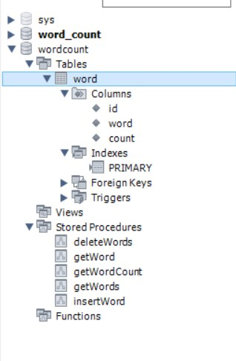
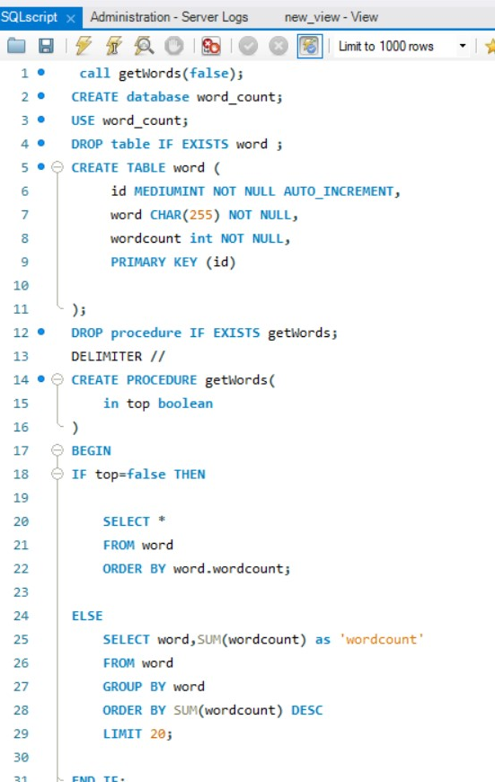
Database Development
Add database support to your word occurrences application.
Add a schema called “word occurrences”. Add a table called “word”. Then, as you parse the document, add new words that are not already in the database like this,
insert into wordOccurrences.word (word) values ('the’);
select * from wordOccurrences..word
Add JDBC support to your Java project In your word occurrence application, instead of storing the frequencies in the array, store/read them from the database

Slide 6
Unit Testing
First of all, when creating a testing plan it proved essential that more code should be separated into classes than what was originally written. For example, error checking was built directly into the UI layer of the code. That was separated into it’s own class. Doing this made it possible to check that those procedures were performing as expected through automated unit testing.
Second of all, when running the automated unit testing, several errors were caught that were not found in initial manual testing. For example, when testing that the website entered was valid, a null value was not tested and error handling for null exceptions was not built in. Another example was that word case was not considered, so the words were converted to lower case before searching and counting.
Unit testing for Word Count application proved to be very beneficial.

